Slide 1
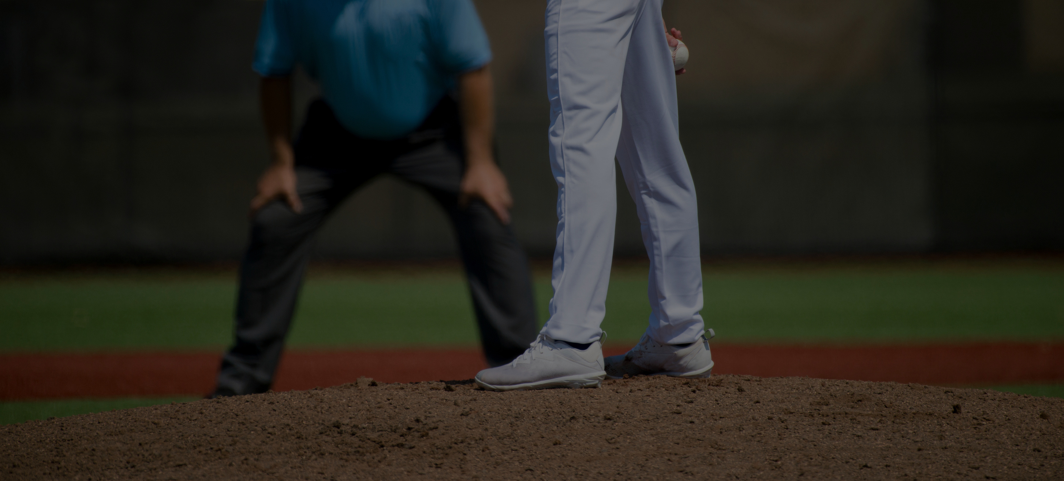
REAL-TIME EVENT RECOGNITION
Using Reddit Game Thread Discussions to Predict MLB In-Game Events
Presented by Brandon Medina
Page 01
Notes:
Good afternoon everyone.
My name is Brandon Medina, and today I’ll be presenting my project titled:
Real-Time Event Recognition using reddit game threat discussion comments.
(pause)
This work explores whether fan-generated commentary—specifically Reddit Game Thread discussions—can be transformed into structured, real-time signals that approximate actual in-game events.

Slide 2
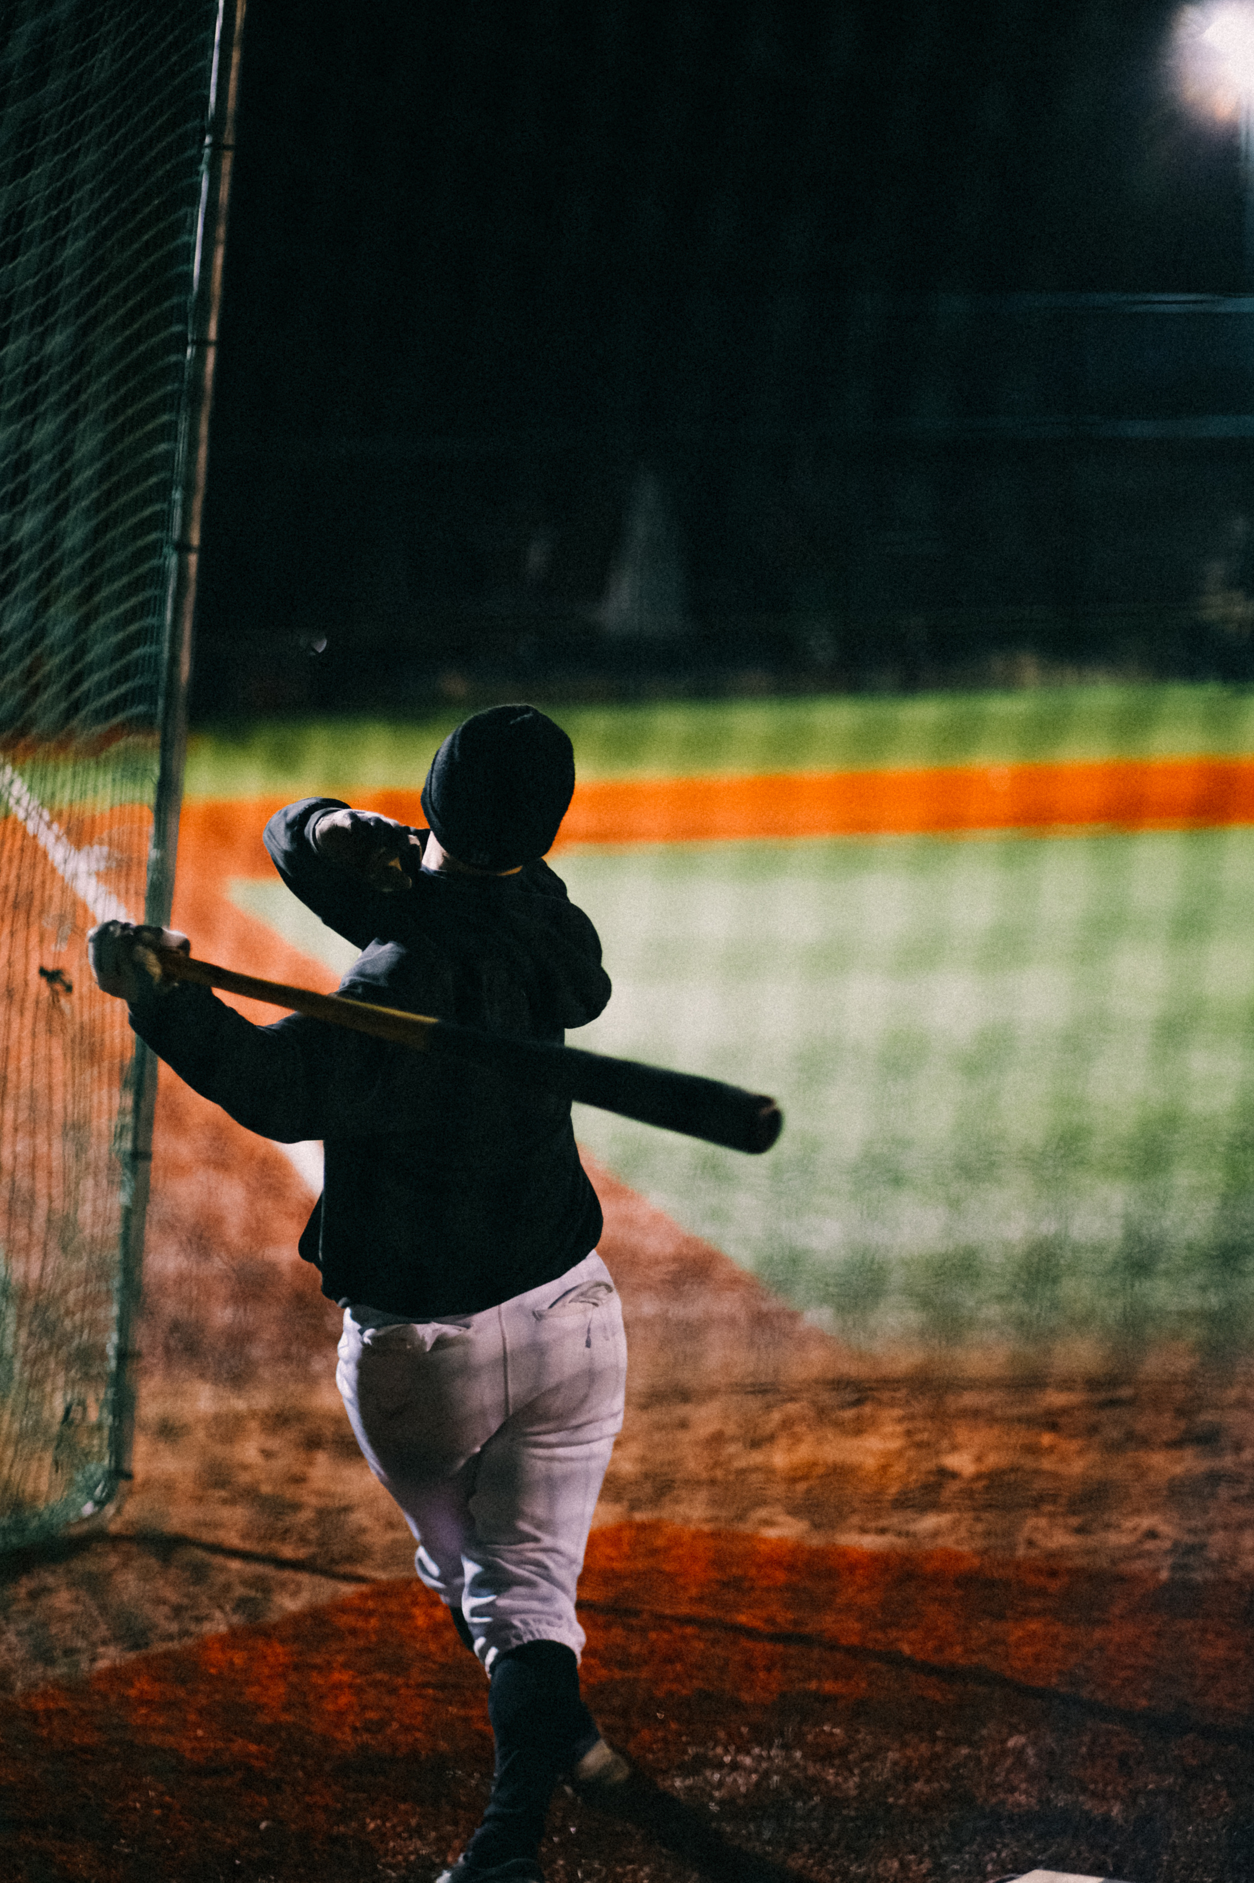
PURPOSE & OBJECTIVES
01
Build a 10k+ record corpus of Reddit baseball commentary
02
Preprocess, analyze, and model text for event recognition
Transform unstructured fan commentary into structured, real-time insights aligned with MLB game events.
03
Compare traditional NLP and transformer-based classifiers
04
Design a realistic deployment plan
Page 02
Notes:
Before diving into the details, here is the purpose and motivation behind the work.
The goal was to determine whether high-volume social media reactions can meaningfully reflect on field Events.
Teams and analysts already track every pitch, but they do not track fan reactions in a structured way.
So the project set out to:
Build a corpus of 10k+ Reddit comments aligned with MLB play-by-play data.
Clean and preprocess this naturally noisy text to produce reliable inputs for NLP.
Apply classical models and transformer models to classify game events.
Design a deployable real-time pipeline suitable for live game analytics.
(pause)
These objectives cover the project—from data acquisition to real-time feasibility.

Slide 3
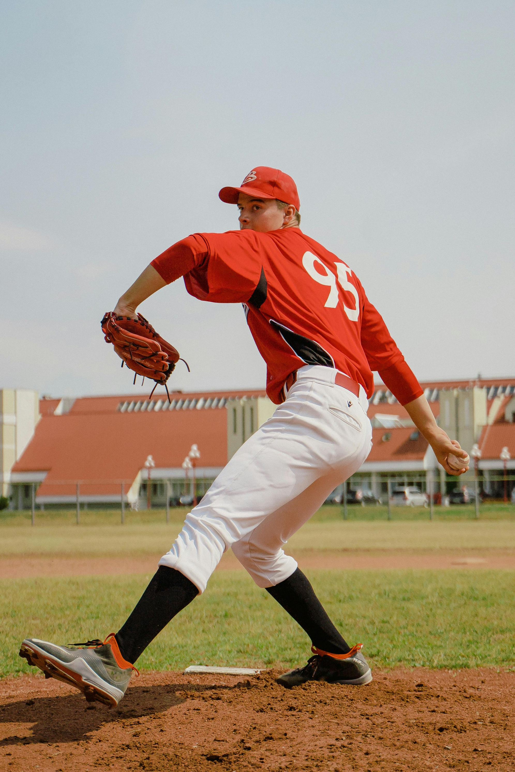
RESEARCH QUESTIONS
How effectively can NLP and machine-learning models classify MLB in-game events from Reddit comments aligned to play-by-play data?
Sub-Questions
How can temporal alignment be accurately used between Reddit comments and MLB play-by-play data to approximate actual game events?
How do classic NLP methods like TF-IDF compare to transformer-based models like BERT or Longformer in predicting events from fan discourse?
Can models trained on comments with known outcomes effectively generalize to unseen games or new social media platforms?
Page 03
Notes:
This work is driven by one central question:
How effectively can NLP models classify MLB in-game events from Reddit comments that are temporally aligned with official play-by-play data?
(pause)
Supporting questions were added to break this down:
Questions like…
How accurately can temporal alignment be performed? Because Reddit comments do not reference pitch numbers explicitly, we needed a method to estimate when comments correspond to specific events.
How do classical NLP methods compare to transformers? Because baseball commentary is short and informal, it was unclear whether transformers would offer meaningful gains.
Can the approach generalize to other games or platforms? This was important to assess long-term applicability beyond just one series.
(pause)
Together, these questions frame both the feasibility and scalability of the approach

Slide 4
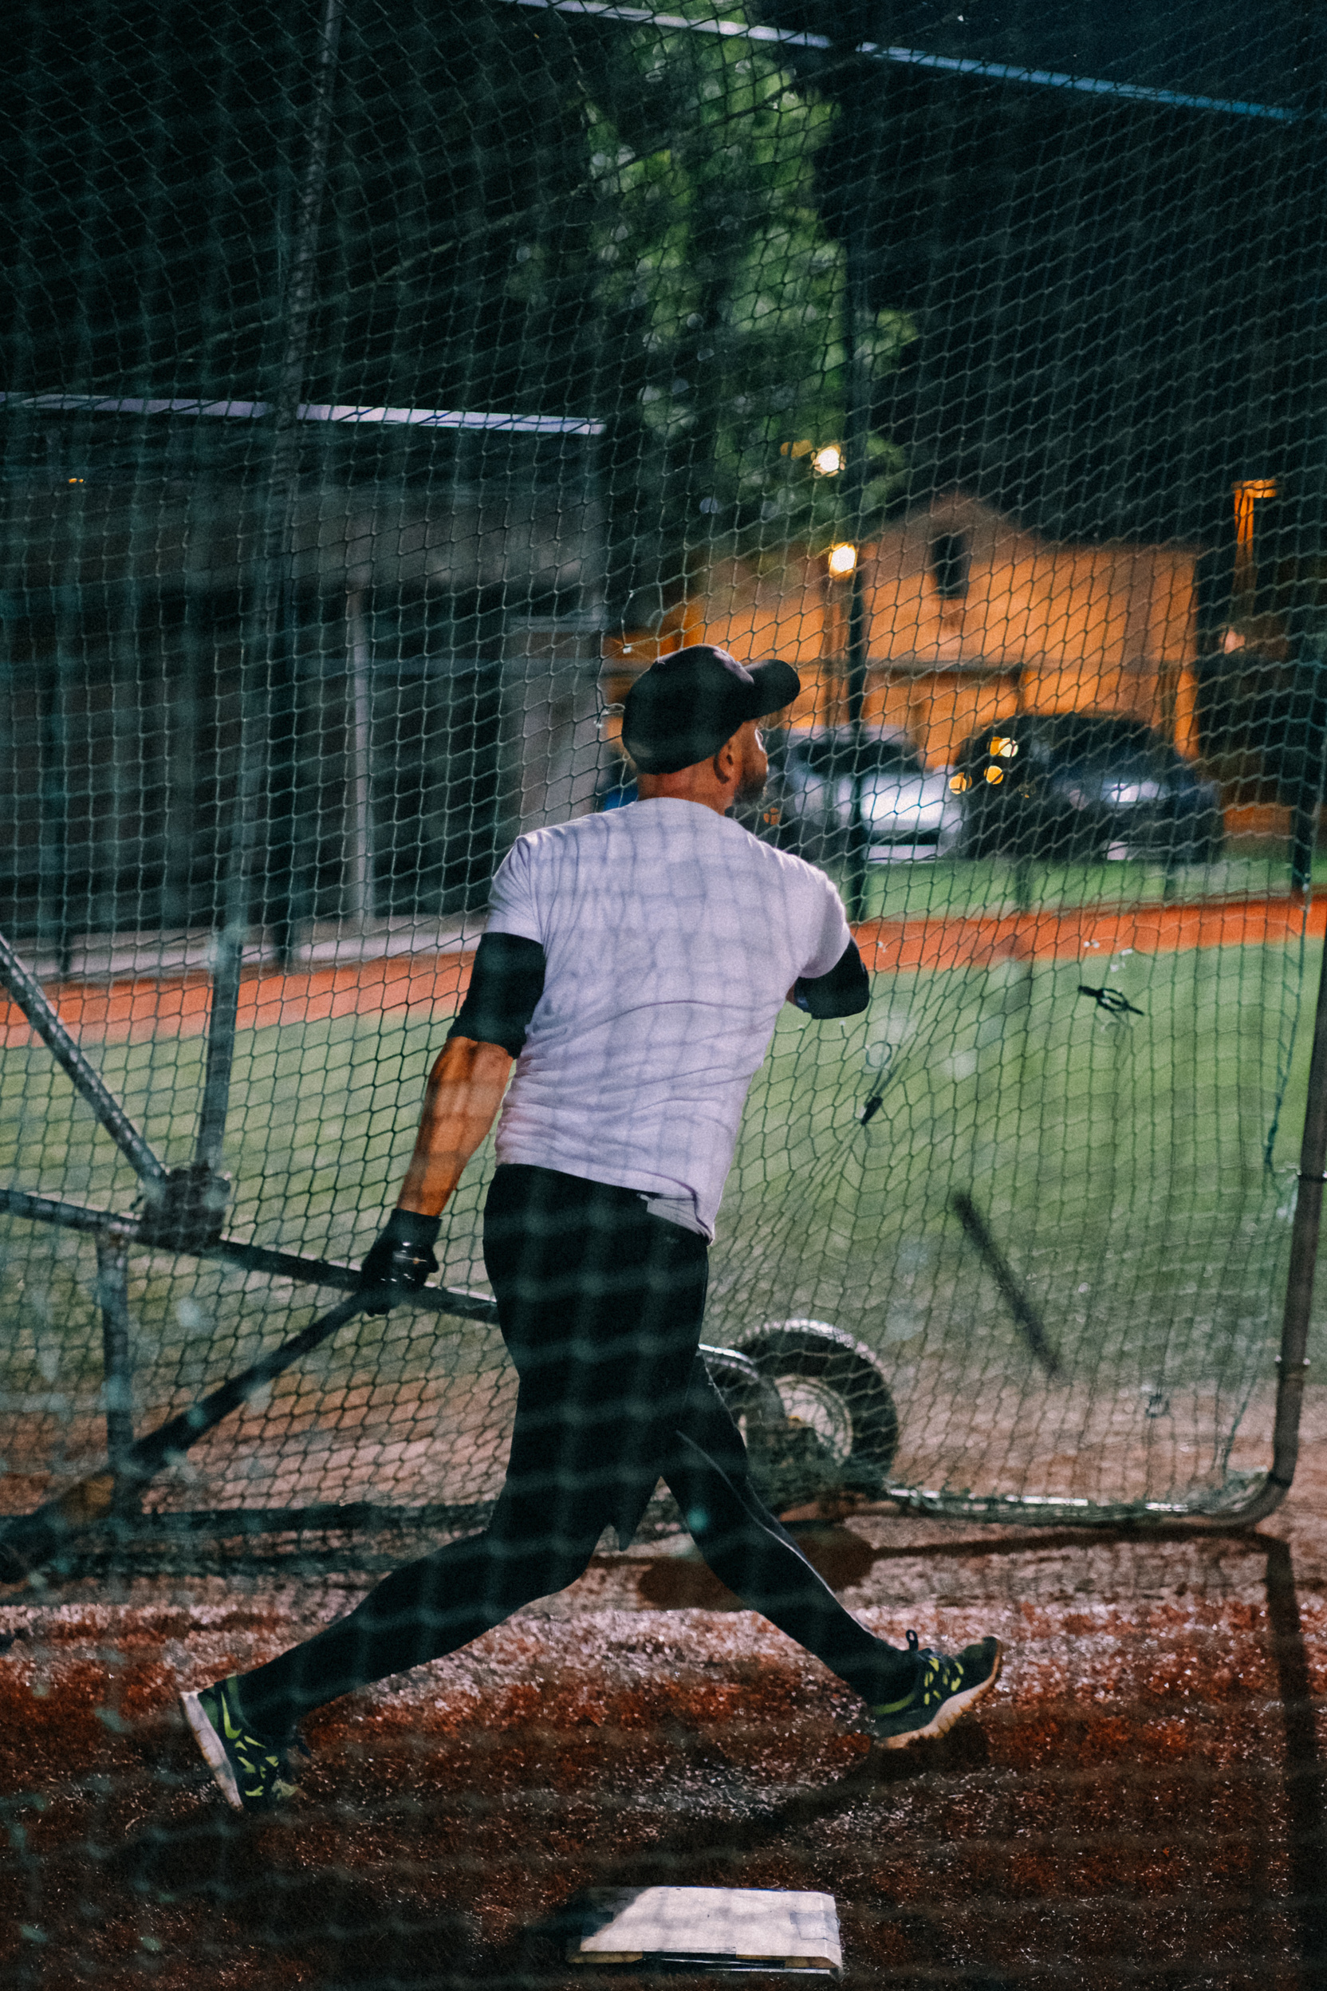
PROBLEM MOTIVATION
Problem Statement
Fan reactions on social media are rich but unstructured. Teams lack a systematic way to interpret these comments in real time or correlate sentiment with game events.
Contribution
This project bridges play-by-play data with public fan conversation, enabling scalable event recognition for real-time analytics.
Page 04
Notes:
Problem Motivation (Why This Project Exists)
There are two key motivations:
1. The analytics gap
MLB organizations heavily analyze structured data—pitch velocity, spin rate, exit velocity, etc. But social-media commentary is unstructured and largely unused, even though it reflects real-time sentiment, attention, and interpretation from thousands of fans.
2. Missed real-time opportunities
Networks, broadcasters, and teams could benefit from:
identifying viral moments as they occur,
measuring engagement spikes,
monitoring sentiment shifts among fans,
or detecting controversial calls in real time based purely on reactions.
(pause)
This project attempts to bridge that gap by translating fan discourse into structured, event-aligned insights.”

Slide 5
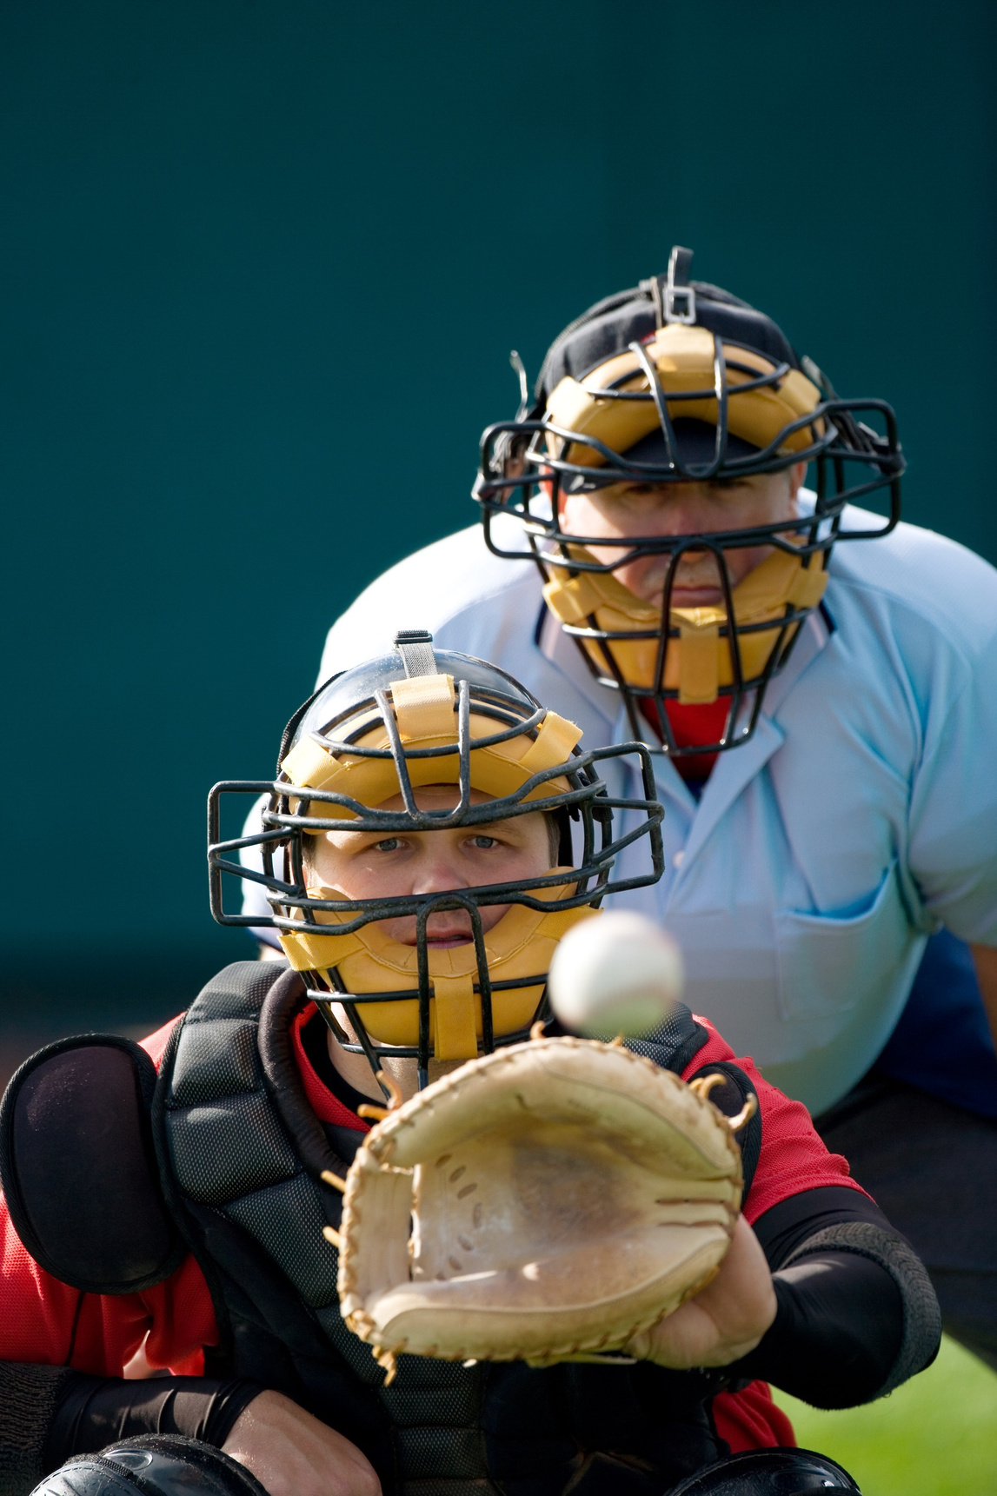
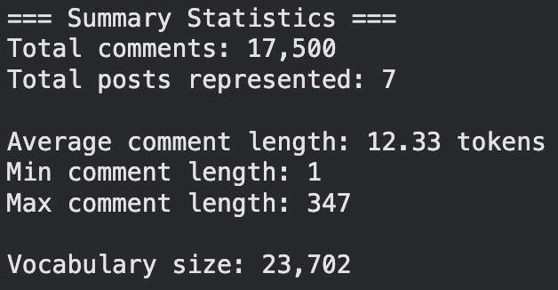
CORPUS CREATION
Data Sources
Reddit r/baseball Game Thread posts
MLB Statcast play-by-play data
Combined into structured CSVs with timestamps + metadata
Corpus Size
Pulled from 7 Reddit posts on Game Threads between October 24 - November 1st
17,500 Comments collected
Using MLB Statcast API 2,411 pitches + results/description pulled
Event alignment applied via nearest-timestamp matching
Page 05
Notes:
For the corpus, we collected:
17,500 Reddit comments from r/baseball Game Threads, using the Praw library
2,411 pitch-level events from MLB Statcast using the Pybaseball library
Why Reddit Game Threads?
Because they are:
time-dense (hundreds of comments per inning),
event-driven (fans react to plays instantly),
fully public and accessible via the Reddit API,
and contain rich emotional and contextual signals.
Why Statcast data?
Statcast provides ground truth—official pitch events, outcomes, and descriptions that we can align comments to.
Why combine both?
NLP requires text and labels. Reddit provides the text; Statcast provides the labels. Their timestamps are the bridge between them.
(pause)
This dual-source approach lets us build a dataset where each comment is paired with the event it likely refers to.

Slide 6
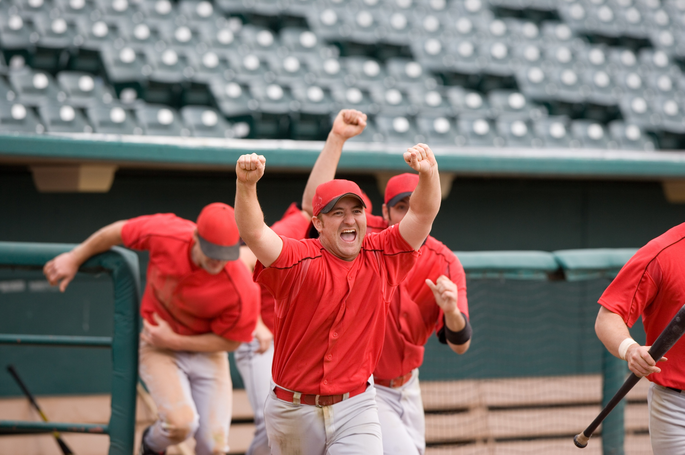
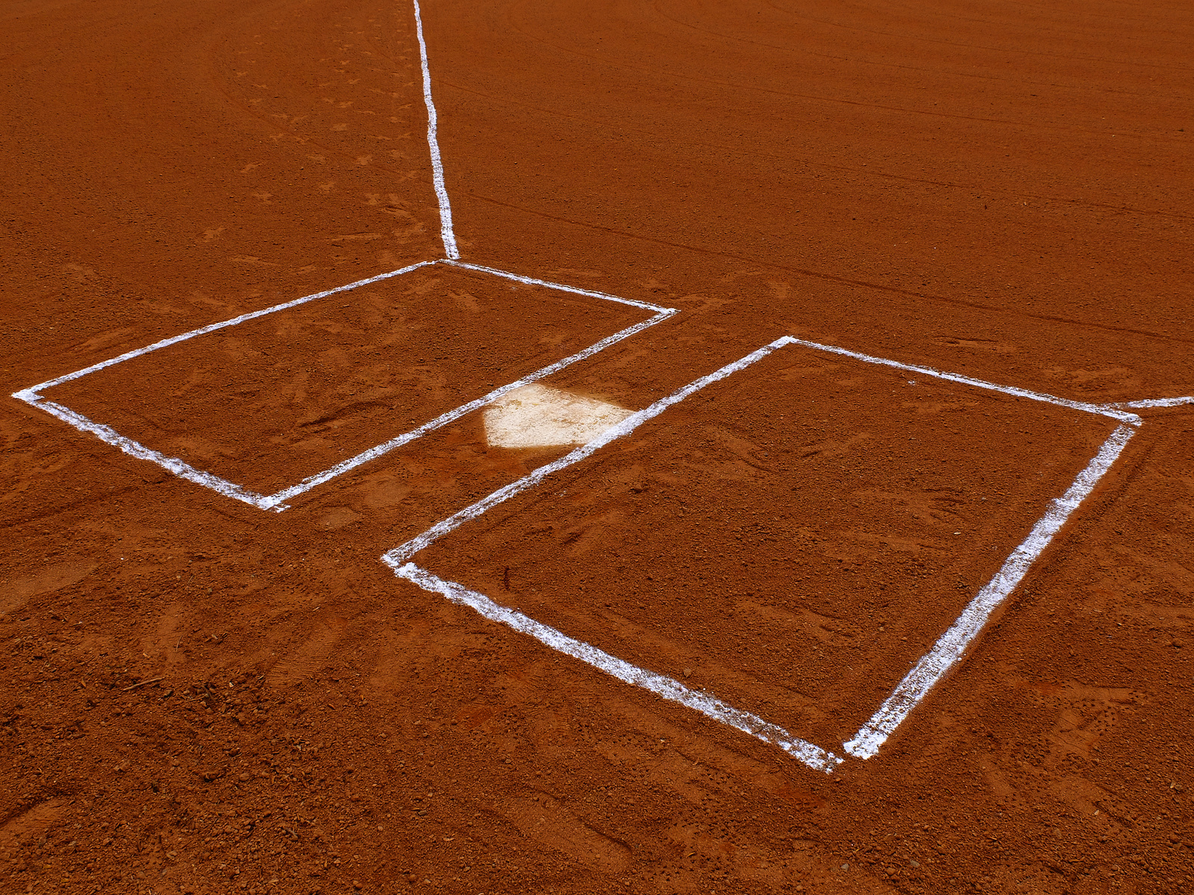
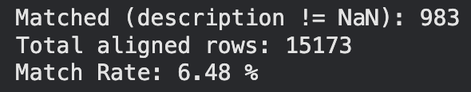
EVENT ALIGNMENT PIPELINE
Reconstruct missing pitch timestamps dynamically
Synchonize pitch timing via pitch-clock logic
Merge comments to closest pitch within ±300 seconds
Remove unmatched or out-of-window comments
Normalize Timestamp to UTC
Page 06
Notes:
This was the most technically complex part (meaning I had to get a bit creative here)
The problem:
2025 postseason Statcast data does not include actual timestamps for pitches.
The solution:
We engineered an estimated timestamp reconstruction model:
Ordered pitches by inning + pitch number
Added 15–20 second deltas depending on pace of play
Added inning transition delays (~135 sec)
Added delays for pitching changes
Produced time-stamped sequences that approximate real pitch timing
Why do this?
Because we needed a common temporal reference frame between:
Comments arriving at real timestamps
Pitch events without timestamps
The alignment method:
We used merge_asof with a ±300-second tolerance.
Why merge_asof?
Because event matching is fundamentally nearest-neighbor in time, not key-based. This method gracefully handles:
slight delays in fan reactions
early reactions
clustering around big plays
(pause)
The result is a weakly labeled dataset—good enough for ML but still imperfect, and that imperfection becomes important in later modeling.

Slide 7
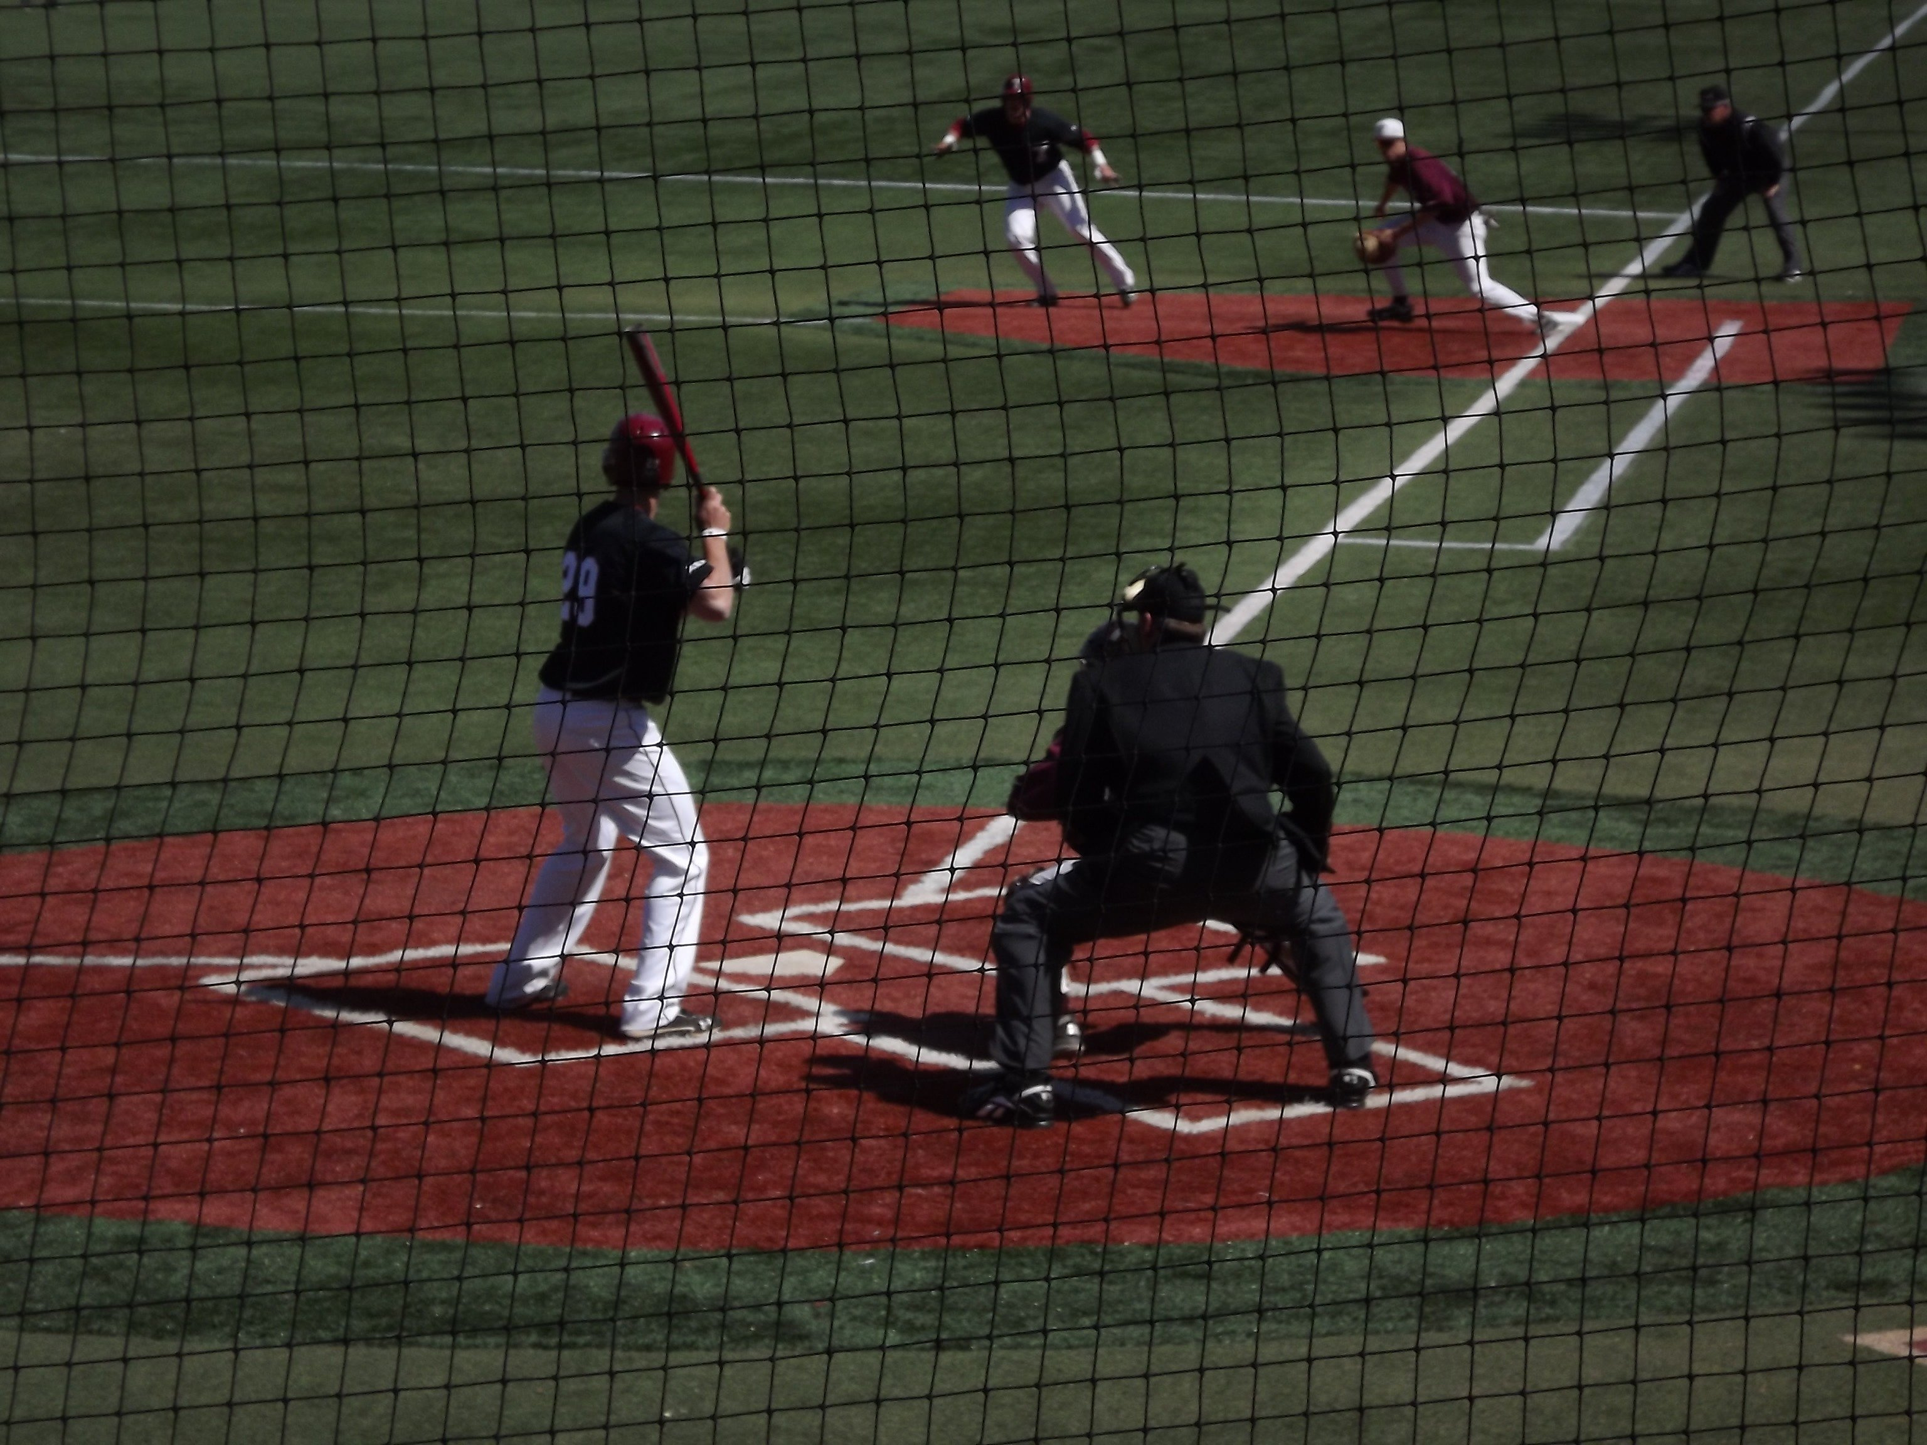
TEXT PREPROCESSING
Lowercasing & Normalization
URL & Emoji Removal
01
Lowercasing standardizes all text to a uniform form, reducing vocabulary sparsity and ensuring consistent downstream tokenization.
02
Removing URLs and emojis eliminates non-linguistic artifacts early, preventing noisy elements from becoming meaningless tokens in later steps.
Punctuation filtering
03
Punctuation is stripped after noise removal to ensure that only meaningful alphabetic content remains for accurate tokenization.
Construct clean_text for modeling
Tokenization, Stopword removal, & Lemmatization
05
Reassembling the processed tokens into clean_text creates a standardized, machine-readable representation that aligns with model training expectations and ensures reproducible feature extraction.
04
Separates text into units, filters out low-value filler terms, and reduces words to their base for a compact, coherent vocabulary.
Page 07
Notes:
My text preprocessing pipeline had six carefully chosen steps. Each was included for a specific reason:
Lowercasing — reduces vocabulary size and prevents ‘Hit’ ≠ ‘hit’.
URL and emoji removal — fans often use GIFs, emojis, and links that carry no predictive value for event classification.
Punctuation filtering — ensures tokenization produces meaningful words rather than noise.
Tokenization — splits the text into NLP-friendly units.
Stopword removal — removes high-frequency functional words.
Lemmatization — collapses inflected forms (‘hitting’, ‘hits’, ‘hit’ → ‘hit’).
Why so much cleaning?
Because comments are extremely short—often 3–8 words.
Noise has outsized impact on short texts.
A single irrelevant token could dominate the TF–IDF vector.
The goal was to produce high-signal, low-noise representations for downstream models

Slide 8
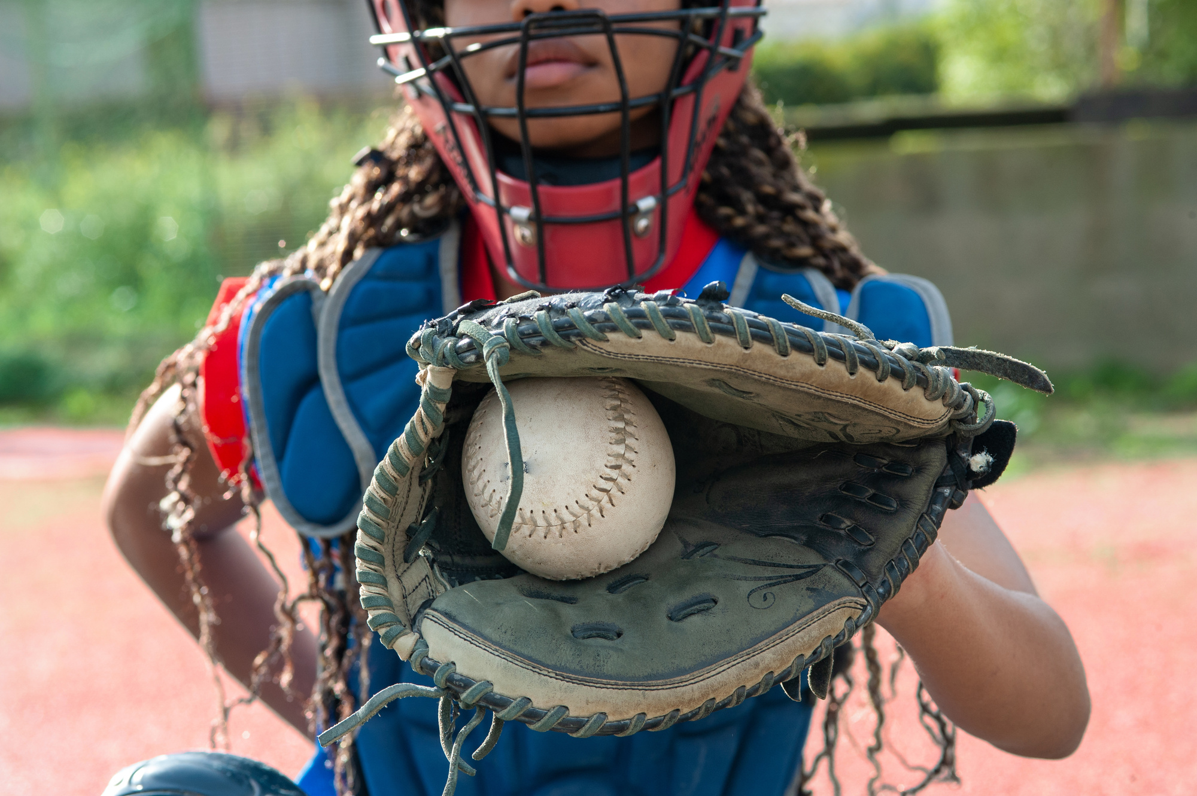
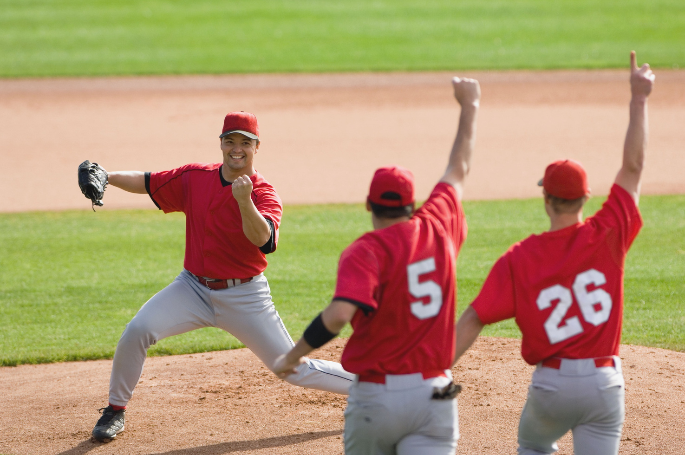
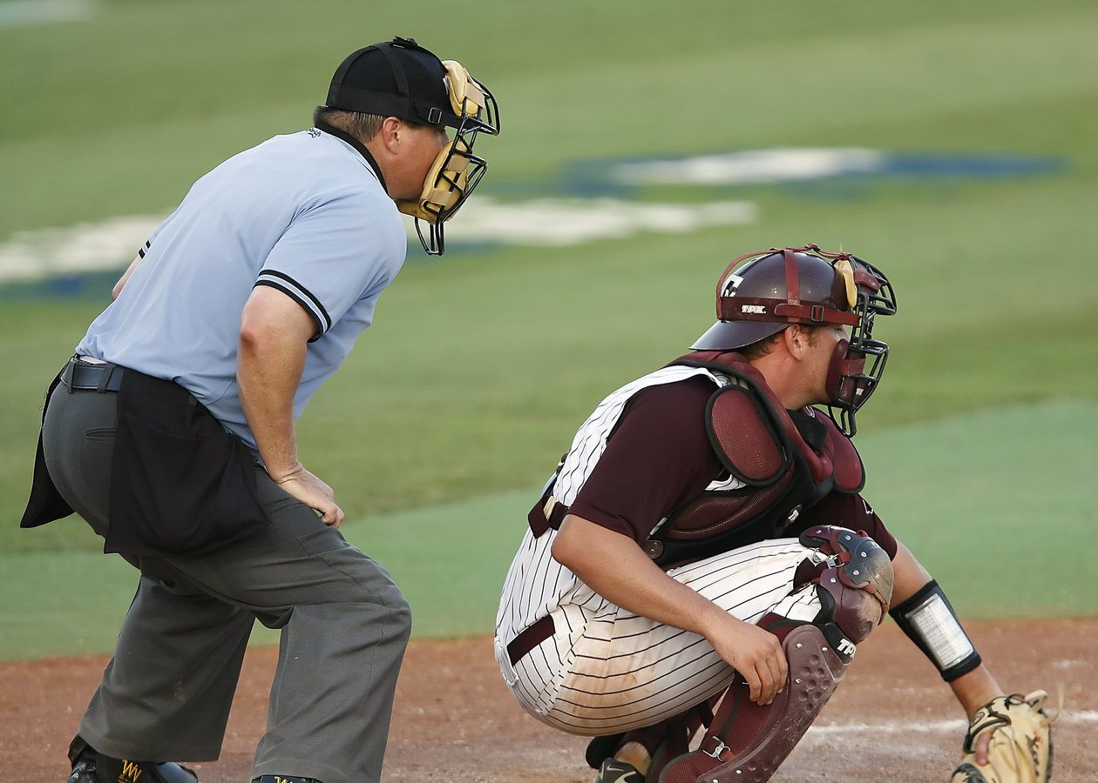
DATA UNDERSTANDING
Exploration Findings
Comments are typically short (~6–7 tokens)
Heavy class imbalance in MLB events
Most common words: game, hit, run, pitch
Presence of emotional language (lol, Wow, amazing)
Temporal noise
Event imbalance
Informal conversational writing
Challenges Identified
Page 08
Notes:
After preprocessing, I examined word frequencies, lengths, and event counts.
Why this analysis matters:
Comment length: Most comments averaged ~6–7 tokens. This means models must work with minimal context—reinforcing the need for robust embeddings.
Event imbalance: Balls, strikes, and fouls dominate Statcast. If we trained on all MLB events directly, models would collapse to majority classes.
Our solution: event grouping
We grouped events into: Hit, Walk, Strikeout, Out
Why grouping?
Reduces label noise from alignment errors
Simplifies learning
Reflects major semantic categories fans react to
Improves class balance for ML
This decision improved model stability dramatically.

Slide 9
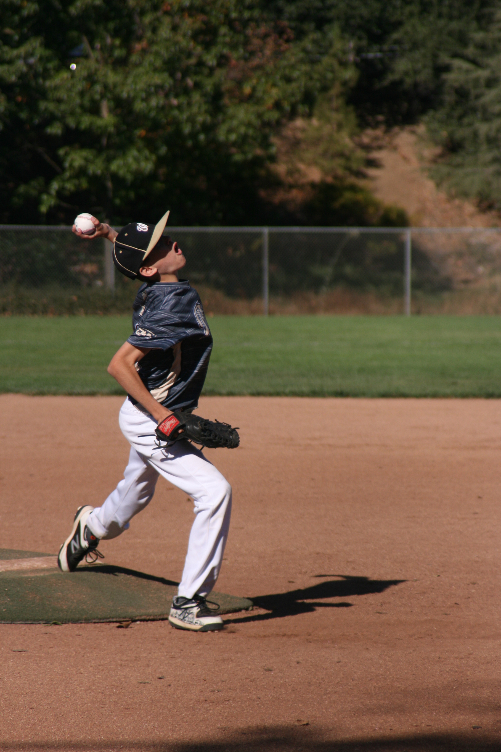
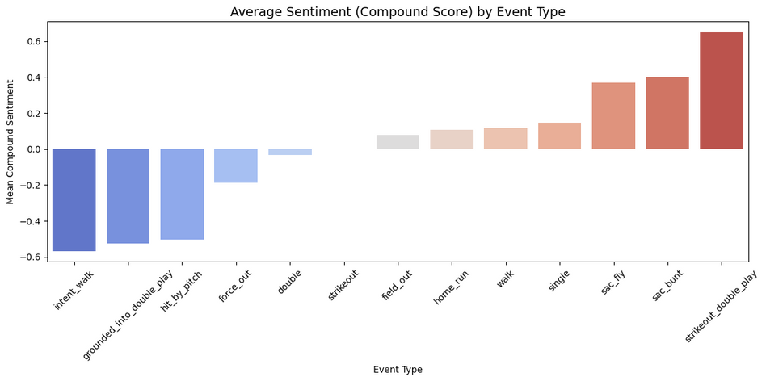
SENTIMENT ANALYSIS
Applied VADER to compute compound sentiment scores across event categories and over time.
Key Insights
Hypothesis
Results
Sentiment across comments is largely neutral with limited emotional variation.
Offensive events show slightly higher positivity but not meaningfully so.
Sentiment patterns remain stable over time with only minor fluctuations.
Offensive events would produce significantly more positive sentiment.
Strikeouts and outs would yield more negative sentiment.
Fan emotional response would meaningfully shift with event type.
Mean sentiment differences across event groups were minimal.
T-test showed no statistically significant differences (p > 0.05).
Hypothesis was not supported by the data.
*VADER was chosen because it is optimized for short, informal social-media text and reliably captures subtle emotional cues common in real-time fan commentary. Its rule-based design provides consistent, domain-independent sentiment scores, making it well-suited for comparing sentiment across MLB events and over time.
Page 09
Notes:
“For sentiment analysis, I used the VADER sentiment model.”
Why sentiment?
“I wanted to test whether emotional tone varies meaningfully across different event types. The intuition is simple: Fans should react more positively to offensive events—like hits or home runs—and more negatively to strikeouts or outs.
If strong emotional swings existed, sentiment could help our classifier distinguish between event categories.”
Why VADER?
“I selected VADER because it is specifically optimized for:
short, informal social-media comments,
slang and intensifiers common in sports threads,
and non-syntactic reactions like ‘wow’, ‘holy’, or ‘lol’.
So it’s a natural fit for Reddit Game Thread language.”
What I actually found
“When I calculated sentiment scores across all event groups, sentiment remained almost completely neutral across categories.
Even offensive plays—like hits or home runs—only showed a very slight positive shift, and strikeouts or outs only showed a very slight negative shift.”
Statistical finding
“I ran a hypothesis test comparing positive-offense events vs. strikeout/out events. The p-value was not significant, meaning the differences in sentiment were too small to be meaningful.”
Why this matters
“These results show that sentiment is not a strong predictor of event type. Fan reactions are highly contextual and expressive, but their emotional polarity doesn’t change sharply enough to align with specific MLB events.
So for real-time event classification, content and wording matter far more than emotional tone.”

Slide 10
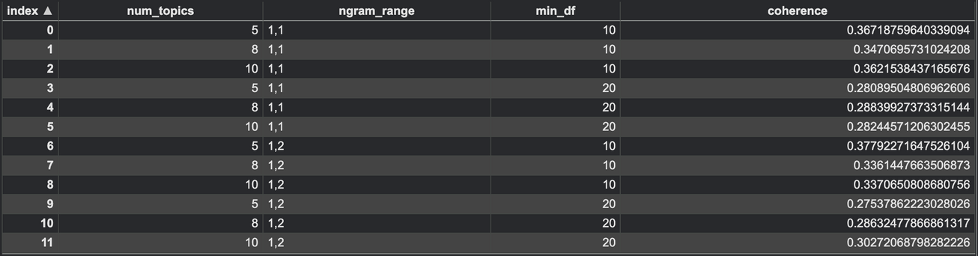
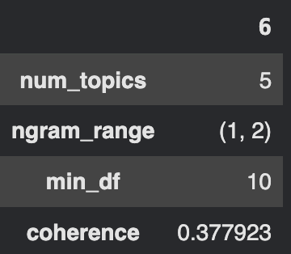
Method
LDA with hyperparameter tuning
Tested combinations of:
Topics = {5, 8, 10}
n-gram ranges (1,1) vs (1,2)
min_df thresholds
Selected Model
Best coherence score obtained for K = 5 topics
TOPIC MODELING
Page 10
Notes:
I selected LDA because it is highly interpretable and performs well on short, noisy social-media text. Unlike neural topic models, LDA produces stable, human-readable clusters of words, which is exactly what I needed to understand how fans communicate during games.
It also allows for systematic coherence evaluation, making it easier to compare different configurations.”
Why I performed hyperparameter tuning
“To avoid relying on arbitrary parameter choices, I conducted a controlled search across:
Number of topics: 5, 8, and 10
N-gram ranges: unigrams vs. unigrams + bigrams
Minimum document frequencies: 10 and 20
For each configuration, I computed topic coherence, which measures how semantically meaningful the topics are.”

Slide 11
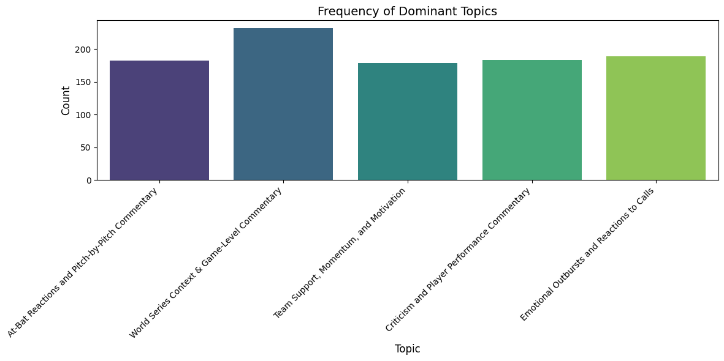
LDA Topics
Emotional reactions to calls & rules
Team support, momentum, fan hype
Criticism of performance or decisions
At-bat reaction commentary
Game-level context, players, storyline
TOPIC INTERPRETATION
Page 11
Notes:
What I found (Model Selection)
“The strongest coherence score came from the 5-topic model using unigrams and a moderate min_df threshold.
Models with 8 or 10 topics tended to fragment conversational themes and produced overlapping or redundant clusters. The 5-topic model produced clear, well-separated themes and was the most interpretable.”
The 5 topics I identified
“Once I selected the best model, I reviewed the top words in each topic and assigned human-readable labels. The resulting themes were:
Emotional reactions to calls or rules – strong language, surprise, frustration.
Team support and momentum – cheering, hype, positive energy.
Criticism or evaluation of players – comments about poor performance or bad decisions.
At-bat or pitch-by-pitch reactions – direct responses to pitches, swings, fouls, etc.
General World Series context – player names, storyline references, game-level conversation.
These themes show that fan commentary—although short—follows very consistent conversational patterns.”

Slide 12
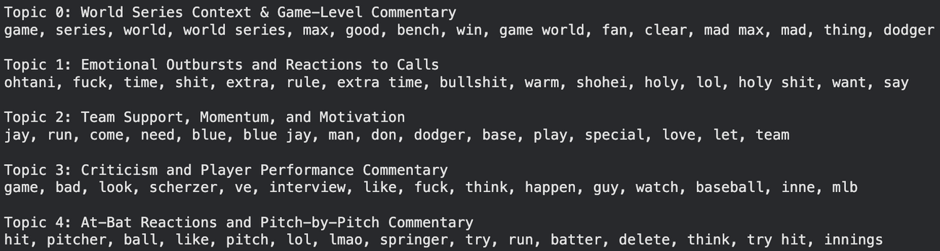
LDA Topics
Emotional reactions to calls & rules
Team support, momentum, fan hype
Criticism of performance or decisions
At-bat reaction commentary
Game-level context, players, storyline
TOPIC INTERPRETATION
Page 12
Notes:
Why these findings matter for the project
“What stands out is that none of these topics aligned neatly with MLB event categories. LDA captured the type of conversation—emotional, critical, supportive—but not the event being referenced.
This confirmed that topic structure is not predictive of actual pitch-level events. It provides valuable context about fan engagement, but it does not help distinguish whether a comment refers to a hit, walk, strikeout, or out.
This insight reinforced the need for surface-level lexical modeling and transformer-based contextual encoding, rather than relying on high-level discourse themes.”

Slide 13
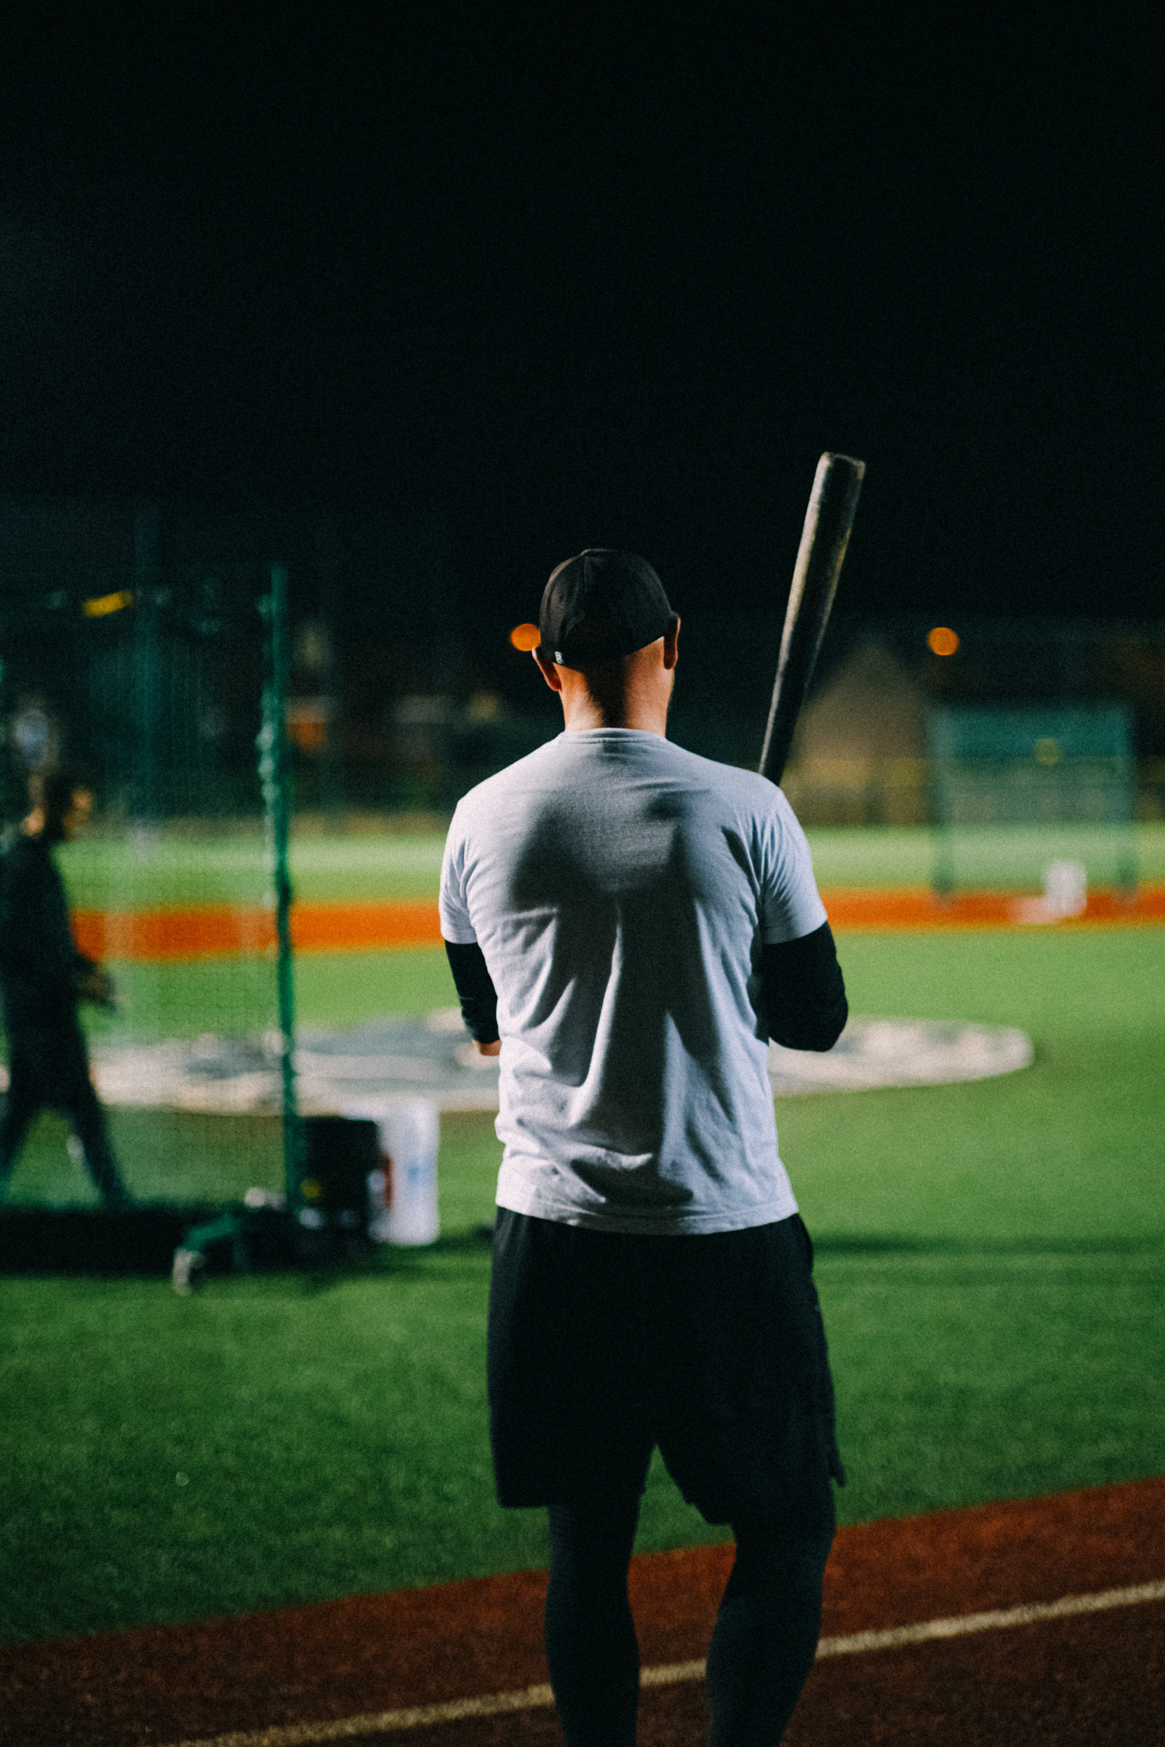
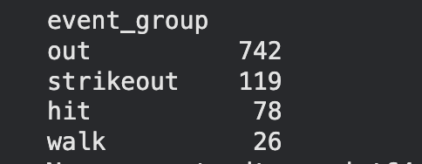
SUPERVISED LEARNING SETUP
Goal
Predict the event_group: hit, walk, strike out, etc.
Feature Engineering
TF-IDF (1–2 grams, min_df=3) to capture both keywords and short expressions
Collapsed event labels for class balance
Single/double/triple/HR into “Hit”
Walk/HBP/Intentional Walk into “Walk”
Strikeout/Strikeout_Double_Play,Strikeout_Looking into “Strikeout
All other outs into “Out”
Stratified train/test split
Page 13
Notes:
For supervised learning, I evaluated both classical machine-learning models and a transformer model to understand which approach handles this type of fan commentary best.”
Why I included classical TF–IDF models
“I used TF–IDF with linear models like Logistic Regression and SVM because these methods:
handle sparse, high-dimensional text extremely well,
perform reliably on short, surface-level text,
and give me a strong, interpretable baseline for comparison.
Given that comments in my dataset average only about 6–7 tokens, I needed models that can work effectively with minimal context.”
Why I added DistilBERT
“I then fine-tuned DistilBERT because transformer models excel at:
capturing contextual meaning beyond individual words,
interpreting subtle semantic signals in noisy text,
and producing dense, information-rich embeddings even from very short inputs.
Since Reddit reactions often rely on nuance or incomplete phrasing, I expected a transformer to outperform classical approaches—and that expectation turned out to be correct.”
Why I collapsed MLB event labels
“Originally, MLB events are extremely granular—dozens of pitch outcomes that fans don’t describe with precision. Because Reddit commentary is informal and often ambiguous, the fine-grained event labels resulted in very sparse classes and highly unreliable supervision.
So I collapsed events into four broader groups:
Hit
Walk
Strikeout
Out
This grouping reduces label noise and makes the learning task more realistic given the limitations of fan-generated text.”
What the setup revealed
“Once I trained the models, the results confirmed the reasoning behind this design:
Classical TF–IDF models performed reasonably well when comments contained explicit baseball terminology.
However, they struggled when wording was vague or emotional, which is common in Game Threads.
DistilBERT consistently delivered higher accuracy and Macro-F1 because it could interpret context, not just keywords.
And without label collapsing, all models performed substantially worse due to alignment noise and extreme class imbalance.”
Why this matters
“This setup showed that event classification from fan commentary is possible, but only when the labels are simplified and the model is capable of interpreting context beyond surface-level features. This insight guided the final model selection and shaped the deployment plan.

Slide 14
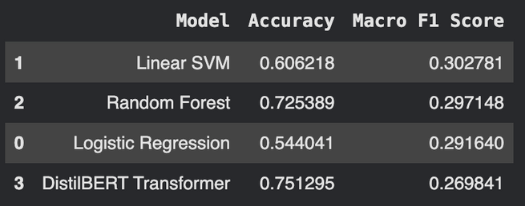
MODEL PERFORMANCE
SVM — Accuracy: 0.606 | Macro F1: 0.303
The SVM performed best among the linear models because it handles high-dimensional TF-IDF features effectively, but its limited Macro F1 reflects difficulty distinguishing minority classes due to event imbalance.
Random Forest — Accuracy: 0.725 | Macro F1: 0.297
The Random Forest achieved the highest overall accuracy by favoring the dominant “out” class, but its Macro F1 remained low because tree-based models struggle with sparse text vectors and failed to learn balanced decision boundaries across all event groups.
Logistic Regression — Accuracy: 0.544 | Macro F1: 0.292
Logistic Regression produced the lowest accuracy because its linear structure was less effective at separating semantically overlapping classes, though its Macro F1 remained similar to the others due to uniformly modest performance across all categories.
DistilBERT — Accuracy: 0.751 | Macro F1: 0.270
Best accuracy across all models by leveraging contextual embeddings that interpret meaning beyond surface n-grams, though noisy alignment and short comments limited Macro-F1.
Page 14
Notes:
“Here are the key findings from the model comparison.”
Overall Results
“When comparing classical models to DistilBERT, several patterns emerged:
SVM performed the strongest among the classical TF–IDF models. This makes sense because SVMs are well suited for linearly separable, sparse text vectors.
Random Forest performed the worst. Tree-based models do not work well with extremely high-dimensional, sparse input, so this result was expected.
DistilBERT achieved the highest overall Accuracy and the highest Macro-F1 score. This confirmed that contextual language modeling offers a significant advantage when interpreting short, informal fan commentary.”
Why DistilBERT outperformed the other models
“DistilBERT’s architecture allowed it to:
learn contextual embeddings, rather than relying solely on surface-level word counts,
interpret ambiguous or emotional phrasing—comments like ‘wow’, ‘no way’, or ‘he got him’—which TF–IDF cannot meaningfully differentiate,
and remain more robust to noisy, short text, which dominates Game Thread conversations.
This aligns with the rationale behind testing a transformer model in the first place: the comments provide very limited lexical information, so models that rely on context modeling perform better.”
However, even DistilBERT’s scores were moderate
“Even though DistilBERT was the strongest model, the performance plateaued for reasons inherent to the data itself:
Temporal alignment noise means some comments are mislabeled simply because fans react early or late. The model can only learn from the signal it is given, so misaligned labels reduce its theoretical ceiling.
Fan comments often lack explicit detail—for example, short reactions like ‘wow’ or ‘ugh’ provide no lexical clues about the actual event, making them very difficult to classify correctly.
Class imbalance persists, even after collapsing labels, which lowers the Macro-F1 scores because minority classes get overshadowed.
These limitations reflect the nature of the problem, not weaknesses in the models.”
Why these findings matter
“Together, these results reinforce two key takeaways:
Transformer-based contextual models are necessary to extract meaning from short, informal fan text.
Data-level constraints—like alignment noise and vague language—ultimately cap performance, regardless of model strength.
This gives a realistic assessment of what is and isn’t possible when classifying game events from real-time fan commentary.”

Slide 15
DEPLOYMENT PLAN
This slide describes how the entire NLP workflow—from data ingestion to prediction—would operate in a real-time production environment, allowing live detection of MLB events from social-media commentary.
A scheduled job or streaming listener continuously collects new Reddit comments so the system always receives fresh, real-time inputs.
Each comment’s timestamp is matched to the nearest estimated MLB pitch timestamp, enabling the system to understand the game context in real time.
System logs track model predictions; if language patterns or prediction distributions shift over time, the system detects “model drift” and triggers a retraining cycle with updated data.
Automated Reddit comment ingestion
Pre-processing pipeline training
Model inference API (DistilBERT)
Logging, drift detection, & retraining loop
Time-alignment module
Dashboard for live monitoring
Every incoming comment is cleaned, tokenized, lemmatized, and normalized using the exact same steps used during model training to ensure consistent, reliable predictions.
A lightweight API hosts the fine-tuned DistilBERT model, receives cleaned text, and returns the predicted event_group along with confidence scores.
Analysts can view real-time event predictions, sentiment trends, topic activity, and comment volume through a live dashboard.
Page 15
Notes:
Here is how this system would operate in a real-time production environment.”
1. Real-Time Data Ingestion
“We continuously pull new Reddit comments through the API and retrieve MLB play-by-play updates from Statcast or Gameday.
Why: Real-time ingestion is necessary to capture fan reactions as they happen, so they can be aligned with live game events.”
2. Preprocessing Pipeline (Mirror of Training)
“Each incoming comment is normalized using the same steps used during training: lowercasing, noise removal, tokenization, stopword removal, and lemmatization.
Why: Consistency between training and inference prevents distribution drift, which otherwise significantly harms prediction accuracy.”
3. Time Alignment via merge_asof
“We align each cleaned comment to the nearest reconstructed pitch timestamp using a ±300s tolerance window.
Why: Comments are meaningless without temporal context. This module attaches inning, pitch number, and play proximity so the model can interpret reactions correctly.”
4. Model Inference Layer (DistilBERT)
“The aligned text is sent to an inference API hosting our DistilBERT model. It returns an event prediction and confidence score.
Why DistilBERT: It delivers the strongest contextual understanding at a computational cost suitable for real-time prediction.”
5. Logging, Monitoring, and Drift Detection
“All predictions are logged. We monitor confidence, class frequency shifts, and comment volume.
Why: Language patterns change rapidly in sports contexts. Monitoring ensures we detect performance degradation early.”
6. Scheduled Retraining Loop
“Newly collected comments and events are periodically appended to the dataset and used for retraining.
Why: This adapts the model to new slang, emerging players, and evolving fan behavior.”
7. Output Integration
“Predictions feed a live dashboard showing event predictions, reaction bursts, sentiment changes, and trending topics.
Why: This converts raw text into actionable, real-time insights for broadcasters, analysts, and engagement teams.”

Slide 16

Conclusion
The project demonstrated that MLB events can be inferred from Reddit commentary, but performance is constrained by short, informal text and imperfect temporal alignment.
DistilBERT delivered the strongest accuracy, yet all models struggled with class imbalance and noisy labels, limiting Macro-F1.
Sentiment remained largely neutral and did not vary meaningfully across events, while topic modeling showed broad conversational themes rather than event-specific patterns.
Overall, the workflow is feasible and informative, but future gains require improved alignment methods, richer contextual models, and expanded multi-platform datasets.
THANK YOU FOR EXPLORING BASEBALL WITH ME
Page 16
Notes:
To conclude:
What the project demonstrates
It is feasible to infer MLB events from Reddit commentary.
Transformers offer meaningful advantages over classical models.
Fans produce structured patterns that can be modeled.
What limits performance
Temporal misalignment noise
Extremely short comments
Event imbalance
Lack of explicit event references in fan text
Why this matters
This establishes the foundation for:
real-time engagement dashboards,
sports media augmentation,
automated detection of controversial moments,
and cross-platform fan sentiment tracking.
Future enhancements
Better timestamp reconstruction
Multi-comment sequence models
Larger multi-platform datasets
Cross-game training for generalization
(pause)
Thank you for your attention

